Slide 1

Today’s video is about
Synchronization timer
using pyRevit

Slide 2


Today we will be using…
Software platforms
Autodesk Revit 2022
Notepad ++ (v8.4.7)
Third party add-ins
pyRevit (4.8.12.22247)
Programming languages
Python (IP2.7)

Slide 3
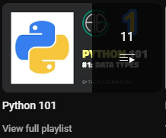

Essential pre-viewing
If you haven’t seen these, I may skip over some things you’re not familiar with.
Python 101
10 quick Python videos
Establish the fundamentals
pyRevit
How to install and set it up
Make a basic toolbar

Slide 4
What are hooks
Event is detected
Application.DocumentSynchronizingWithCentral
Event is detected
by pyRevit
Run ‘hook’ script
doc-syncing.py

Slide 5
What we will cover
Preparing the tool
What are hooks
Types of hooks
Save/load data
Developing the tool
Writing the begin sync hook
Writing the end sync hook

Slide 6
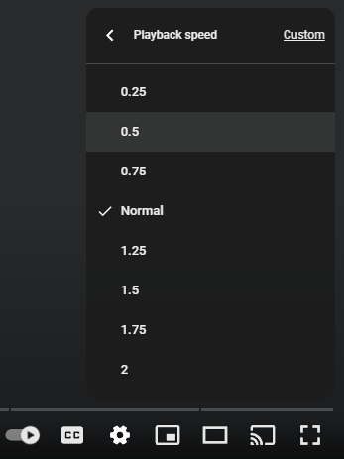

Let’s dive in!
And make our own solution!
Am I talking too fast?
Slow me down if you like!

Slide 7
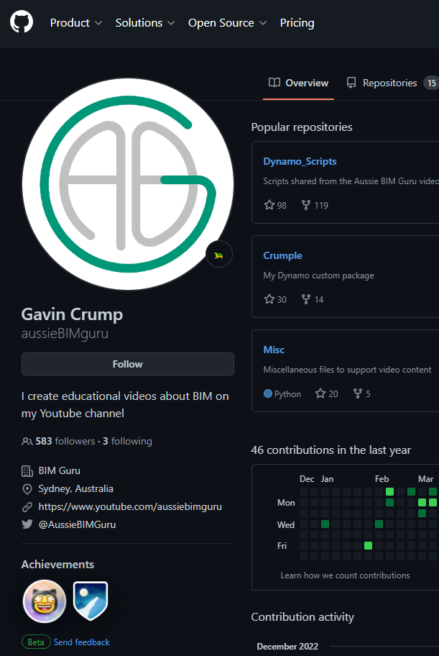
Find my stuff at >>
Aussie BIM Guru’s github
https://github.com/aussieBIMguru

Slide 8

Thanks for watching!
You can contact me at…
aussiebimguru@gmail.com
Got a video request?
Leave it in the comments – I reply to every single one!

